Slide 1
Credit
Chapter 15

Slide 2
Credit IQ Quiz
http://www.inspirefinanciallearning.ca/index.php/tools-videos/interactive-tools/credit-iq-quiz/

Slide 3
Get it on Credit Clip
http://www.getsmarteraboutmoney.ca/en/managing-your-money/planning/managing-debt/Pages/video-get-it-on-credit.aspx#.VXcdYtJVhHw

Slide 4
What is Credit?
Using someone else’s money to purchase an item or service now and then pay for it later.
Types of Credit
Credit Cards
Student Loans
Loans or Lines of Credit
Overdraft Protection
High Cost Loans
Notes:
WHAT IS CREDIT?
Credit can be good or bad depending the the debtors use of it.
Positive uses of credit include using it to avoid draining savings or to start up a new business.
When individuals borrow beyond their ability to repay debt, financial difficulties occur.
Consumer Credit
Consumers should be aware of and weight the advantages and disadvantages of credit.
See “To Use or Not to Use Consumer Credit?” on page 469.

Slide 5
Consumer Credit
Credit is used for personal items (home, car, concert tickets etc.)
Notes:
WHAT IS CREDIT?
Credit can be good or bad depending the the debtors use of it.
Positive uses of credit include using it to avoid draining savings or to start up a new business.
When individuals borrow beyond their ability to repay debt, financial difficulties occur.
Consumer Credit
Consumers should be aware of and weight the advantages and disadvantages of credit.
See “To Use or Not to Use Consumer Credit?” on page 469.

Slide 6
Consumer Credit
Advantages
Disadvantages
instant enjoyment
convenience
emergencies
credit rating
credit costs (interest)
impulse buying
overbuying
financial difficulties
Notes:
Consumer Credit
See Figure 15.1, “Advantages and Disadvantages of Using Consumer Credit”, on page 468.
Advantages of Credit
Instant enjoyment means buying the goods or services on credit and using it now and paying later.
Using credit is convenient as you do not need to carry cash and cheques while shopping or traveling.
Credit can come in very handy when there is an emergency and money is needed now.
Credit allows people to save money by taking advantage of sales.
Buying on credit is one way to establish a credit rating.
A credit rating is an indication of the level of risk that a consumer, business, or government will pose if credit is granted.
The monthly statement received from the creditor can help individuals budget and record spending.
Disadvantages of Credit
There are costs involved when buying on credit not fully present when using cash (losses passed on to consumers and interest charges).
With access to credit some consumers buy impulsively and do not comparison shop or check the details of the sale.
With access to credit some consumers overbuy, purchasing things they do not need or that they cannot afford.
Many consumers get themselves into financial difficulties by mismanagement of credit, basically spending more than they can afford.

Slide 7
Business Credit
Long-term credit to purchase land, buildings, and equipment, and short-term credit to buy goods, raw materials, and supplies.
Notes:
Consumer Credit
See Figure 15.1, “Advantages and Disadvantages of Using Consumer Credit”, on page 468.
Advantages of Credit
Instant enjoyment means buying the goods or services on credit and using it now and paying later.
Using credit is convenient as you do not need to carry cash and cheques while shopping or traveling.
Credit can come in very handy when there is an emergency and money is needed now.
Credit allows people to save money by taking advantage of sales.
Buying on credit is one way to establish a credit rating.
A credit rating is an indication of the level of risk that a consumer, business, or government will pose if credit is granted.
The monthly statement received from the creditor can help individuals budget and record spending.
Disadvantages of Credit
There are costs involved when buying on credit not fully present when using cash (losses passed on to consumers and interest charges).
With access to credit some consumers buy impulsively and do not comparison shop or check the details of the sale.
With access to credit some consumers overbuy, purchasing things they do not need or that they cannot afford.
Many consumers get themselves into financial difficulties by mismanagement of credit, basically spending more than they can afford.

Slide 8
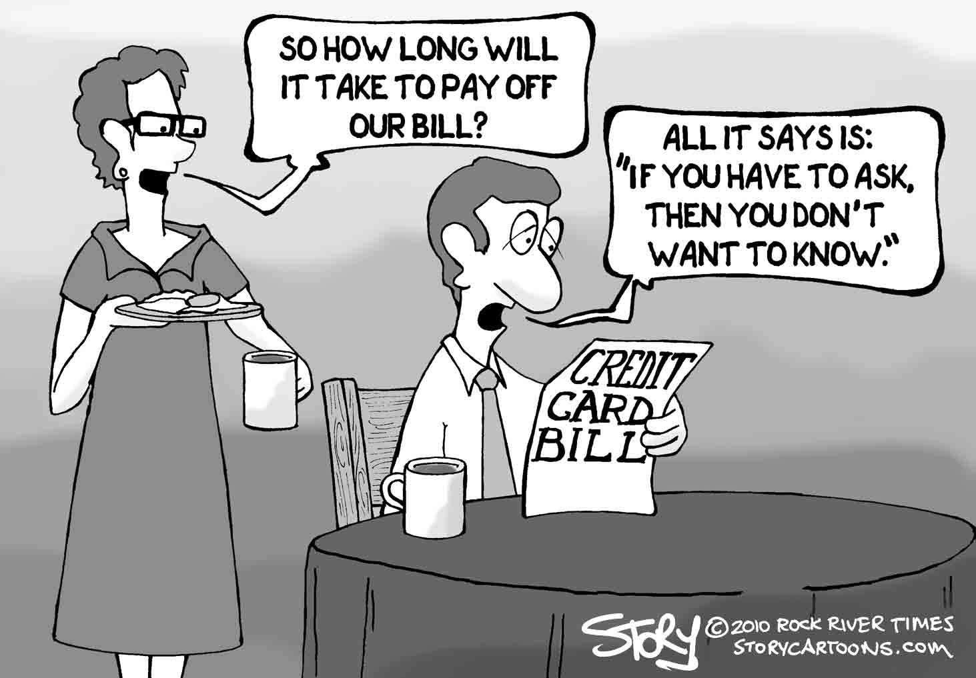

Slide 9
Credit Worthiness
Three Cs of credit
How a lender decides to lend money
1. Character
borrower’s willingness, reliability, and trustworthiness to make a loan repayment.
2. Capacity
borrower’s ability to make payments on time
3. Capital
value of borrower’s assets that could be used to repay debts.
Notes:
CHARACTER
Questions that a lender could ask an individual to determine character:
Do you pay your bills on time?
Have you used credit before?
How long have you lived at your current address?
Where do you work, and how long have you held your present job?
Questions that a lender could ask a business to determine character:
Does the business pay its bills on time?
Has the business used credit previously without problems?
How long has the business existed?
Are the owners reliable?
Answer to these questions seek to determine responsibility and stability.

Slide 10
Class Activity
Based on the 3 C’s of credit, develop a personal assessment of your own credit worthiness for a $500 loan. If you were a loan officer at a bank, would you lend $500 to you? Why or why not?

Slide 11
Credit Bureaus
Business that gathers credit information on borrowers and then sells it to credit grantors and lenders.
Credit Rating
level of risk that a consumer, business, or government will pose if credit is granted.
If you have a poor credit rating, won’t be able to get a loan
Notes:
CREDIT BUREAUS
Retail stores and financial institutions are the main customers of credit bureaus.
Information collected by the bureaus is similar because most national and international creditors are registered with all three.
Credit bureaus do not rate borrowers; they gather information on them and keep it on file for seven years.
Individuals and businesses that do not use credit (cash) do not establish a credit record.
Credit reports help businesses make better decisions.
Since lenders are able to make faster decisions regarding granting credit, consumers benefit.
CREDIT RATING
Credit rating is a measure of credit worthiness.
A good credit rating results when a borrower:
Carries no outstanding balance on credit cards
Pays all bills on time
Keeps debt to a reasonable level; based on income and assets
Has taken out a loan, meeting all payment obligations on time
A lower credit rating results when a borrower:
Pays bills late
Has too many credit cards
Owes large sums of money as well as a mortgage
Applies for many loans or credit cards in a short time period
Has declared bankruptcy

Slide 12
Credit Crisis
Signs of credit crisis include:
consistently unable to pay off your credit cards
using cash advances for everyday living expenses
not knowing how much debt you have
seeming to always be in debt
Notes:
CREDIT CRISIS
Credit crisis is not uncommon.
Getting out of Debt
When individual and businesses experience a credit crisis they should not panic nor should they avoid their creditors.
Spending habits, financial goals, and lifestyle need to be re-accessed when a crisis occurs.
A consolidation loan, is a consumer loan (often with lower interest rates) that combines all of the borrower’s debts into one more manageable loan.
Credit counselling services are not-for-profit consumer debt counselling services that provide unbiased assistance for individuals and families experiencing money and credit problems.
Credit counsellors discuss options and help to develop a course of action to get out of debt.
Counsellers can help with budgets and can contact creditors to arrange debt-management plans and reduced payments.

Slide 13
Getting out of Debt
Steps to get out of debt:
contact and explain difficulties to creditors
be honest and realistic when working with creditors on a plan
pay a portion of overdue payments
put away credit cards
seek help from credit counselling services
Notes:
CREDIT CRISIS
Credit crisis is not uncommon.
Getting out of Debt
When individual and businesses experience a credit crisis they should not panic nor should they avoid their creditors.
Spending habits, financial goals, and lifestyle need to be re-accessed when a crisis occurs.
A consolidation loan, is a consumer loan (often with lower interest rates) that combines all of the borrower’s debts into one more manageable loan.
Credit counselling services are not-for-profit consumer debt counselling services that provide unbiased assistance for individuals and families experiencing money and credit problems.
Credit counsellors discuss options and help to develop a course of action to get out of debt.
Counsellers can help with budgets and can contact creditors to arrange debt-management plans and reduced payments.

Slide 14
10 Tips for Wise Credit Card Use
http://www.cbc.ca/news/canada/10-tips-for-wise-credit-card-use-1.1037332

Slide 15
Credit Card Simulator
http://www.channelone.com/interact_post/credit-card-simulator/

Slide 16
TO DO
Worksheet:
The cost of Borrowing
Borrowing Money and My Future Goals

Slide 17
Marketplace Episode Easy Loans: Uneasy Money
http://www.cbc.ca/marketplace/episodes/2014-2015/easy-loans-uneasy-money

